Slide 1
Today’s Agenda
Finish Wednesday lecture.
Discuss Prerogative Powers of the Presidency
Setting the Agenda
Organizing Chain of Command
Taking the Initiative
Structures of WH foreign policy making
NSC
Advisory styles
Judicial Interventions

Slide 2
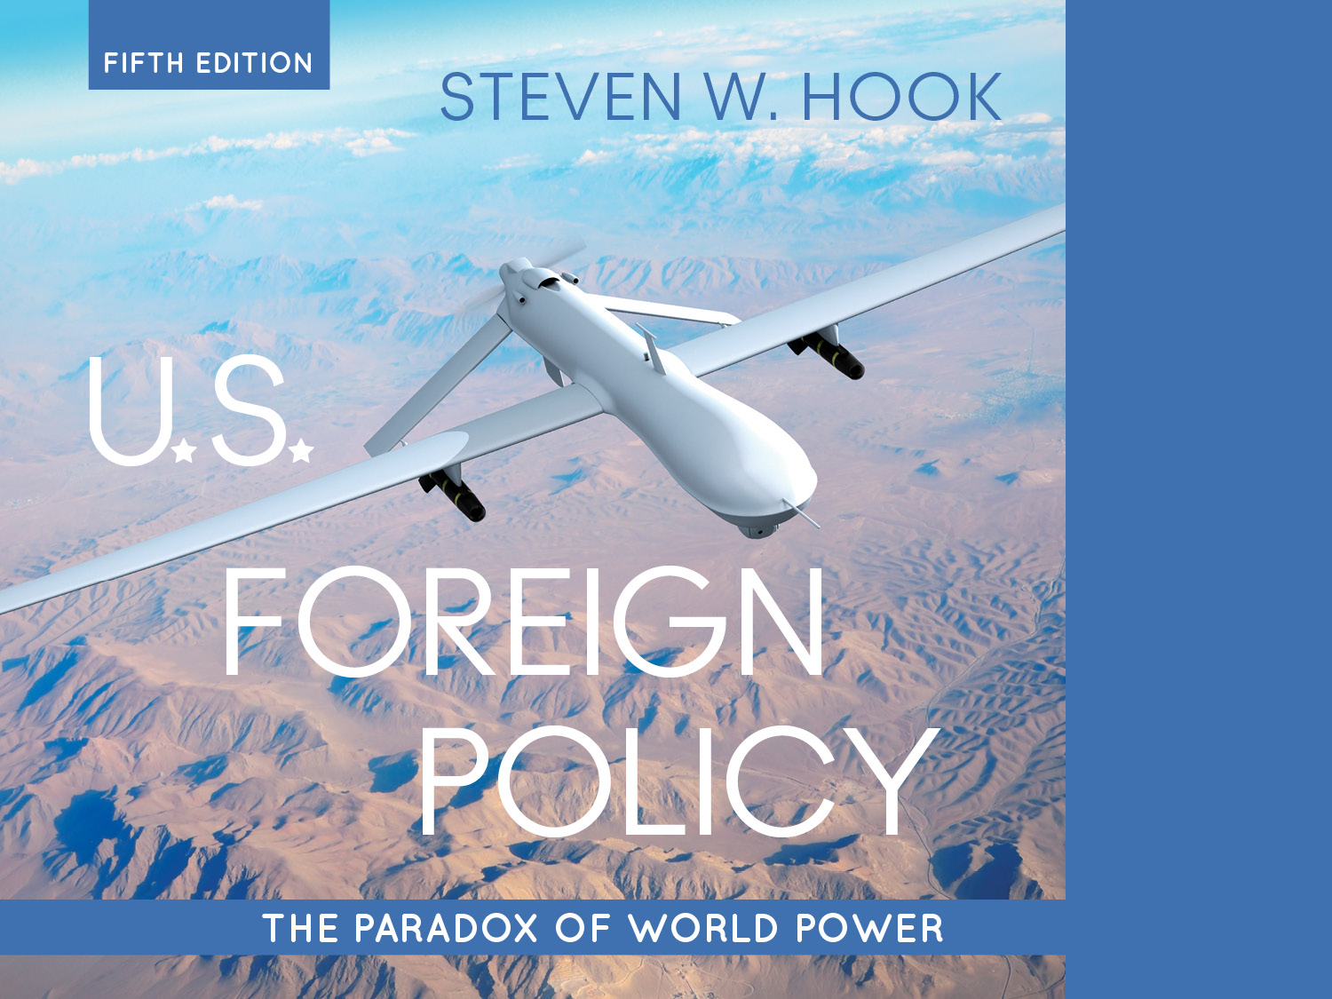
4. Presidential Power

Slide 3
White House Advantages over Congress
Informal powers: Norms, routines, and natural advantages for the president in foreign affairs
National constituency: The president represents all the people
Bully pulpit: Unparalleled access to the general public through media
Status as party leader: The president is at the head of the political party and of the party in government
Perpetual session: Unlike Congress, the president is always “in session” and is a unitary actor
The bureaucracy’s CEO: Leadership or control of executive agencies
Information dominance: Information and resource control, specifically by councils and agencies of national security
Notes:
Do we see (or not see) these advantages in the current administration?

Slide 4
Constraints on Presidential Power
Domestic and international factors to consider as constraints on presidential power
Developments overseas: Uncertainty regarding international conditions, emergence of crises
September 11 attacks
Russia’s annexation of Crimea
Domestic politics: Party control of Congress
Personal limitations: Time, personal background, psychology, and available information all impact decision-making
Notes:
Issue of experience in foreign policy, or lack thereof.

Slide 5
Constraints on Presidential Power
Foreign policy issues also vary with administrations, and crises can affect foreign policy
Time
Resources
Partisan politics
Elections
Media
Public opinion
The importance of context.
What is the current context of presidential foreign policy power?
Notes:
Learning Objective Number: 4.1

Slide 6
Presidential Prerogative in the “Zone of Twilight”
Presidential prerogative (i.e., discretion) is greatest when . . .
Congress and the president have concurrent authority
OR
Power distribution between Congress and the president is uncertain and Congress has not asserted authority
Notes:
Learning Objective Number: 4.2
So, let us take a closer look at these prerogative powers of the Presidency, Hook lists three:

Slide 7
Setting the Foreign Policy Agenda
Informal power of planning a grand strategy, from large-scale doctrines to specific tactics
(State of the Union)
What is the current agenda?
Doctrines or large-scale agendas for foreign policy strategies allow presidents a great deal of influence in foreign policy making
Doctrines are subject to constraints by Congress and public opinion
Notes:
Learning Objective Number: 4.2

Slide 8
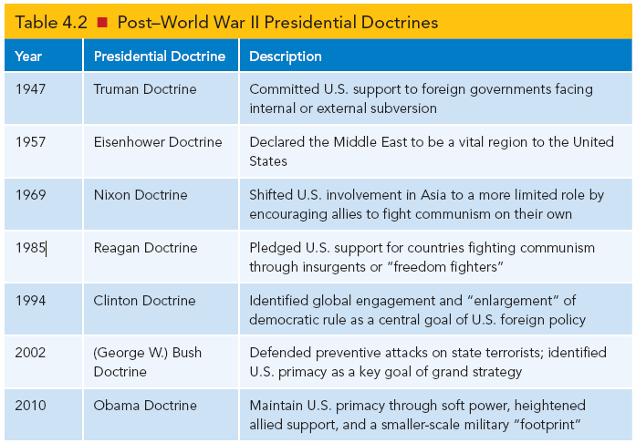
Setting the Foreign Policy Agenda
Notes:
Learning Objective Number: 4.2
What’s the Trump version of a doctrine?

Slide 9
Organizing the Chain of Command
Presidents have the power to organize the executive branch
Inner circle of White House advisers, staff, and cabinet members
Advisory networks or circles of advisers and subgroups of personnel to provide information to the president
Circles and networks vary with presidential administrations
National security advisers and cabinet secretaries have different powers and roles under each administration
Notes:
President’s can surround themselves with advisors who help them implement their agenda.

Slide 10
Taking the Initiative
Presidents can dictate everyday events, what the media covers, and day-to-day foreign policy
Presidents can command military interventions without the consent of Congress in cases of short-term invasions and threats to national security (fait accompli)
Ronald Reagan in Grenada
George H. W. Bush in Panama
Bill Clinton in Bosnia and Kosovo
Notes:
Closely connected to the national constituency and perpetual session advnatages.

Slide 11
Structures of the “Presidential Branch”
White House is the nucleus of foreign policy making
Growth of power and resources surrounding the president (institutional president)
Growth of councils in the White House
Creation and growth of the Executive Office of the President (EOP)
Security complex, creation of councils to advise presidents in foreign policy making
Constraints on president; competition between cabinets and staff
These developments reflected the new position of global power the country assumed after WWII
Notes:
Learning Objective Number: 4.3

Slide 12
Structures of the “Presidential Branch”
National Security Council (NSC): created in 1947 to advise the president and help increase cabinet participation in the security process
Flexible, ad hoc role for each administration
Often creates rivalries between actors and institutions
Problems and complications with presidential branch and staff
Not subject to Senate confirmation
Somewhat secretive decision-making
Competition and redundancy in staff positions as in other government agencies
Notes:
Learning Objective Number: 4.3

Slide 13
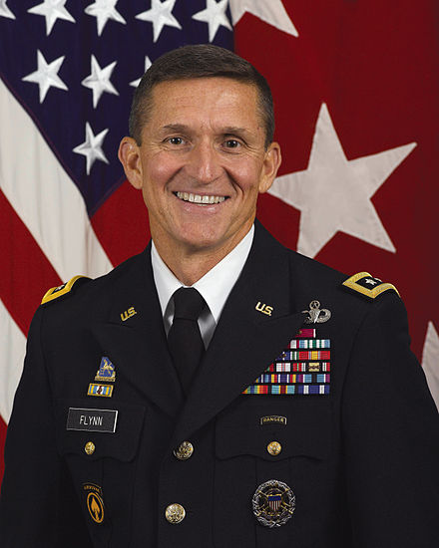
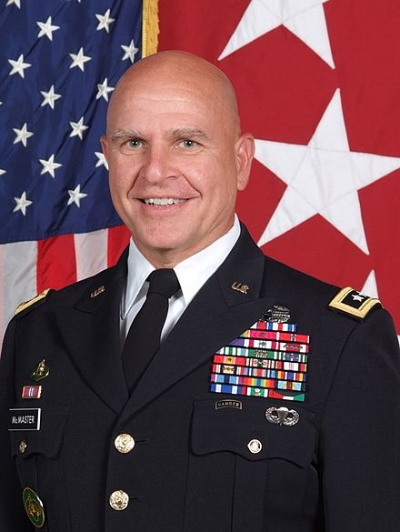
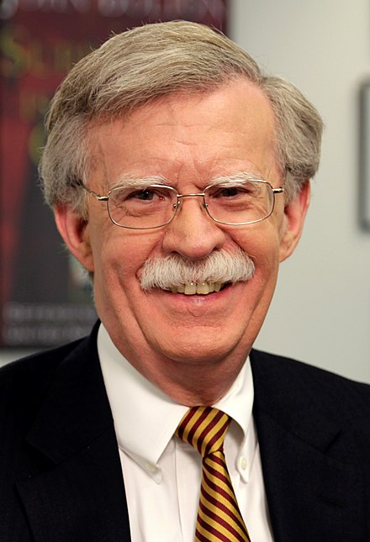
Trump’s NSC

Slide 14
Advisory Systems in the Inner Circle
Management style of leaders: Shapes the role their advisory systems play
Three models
Formalistic: orderly, hierarchical (e.g., George W. Bush)
Competitive: open debate, less formal channels of advisers (e.g., Franklin Roosevelt)
Collegial: informal subgroups with openness and competition (e.g., Bill Clinton and Barack Obama)
Can we discern a particular type of management style in the Trump administration?
Notes:
Learning Objective Number: 4.3

Slide 15
Judicial Interventions in Foreign Policy
Courts generally see foreign affairs as political rather than legal issues
Political issues should be resolved in the political arena by Congress and the president
Tend to rule on issues of First Amendment rights
Tend to rule when domestic and international policy are intertwined
Notes:
Learning Objective Number: 4.4

Slide 16
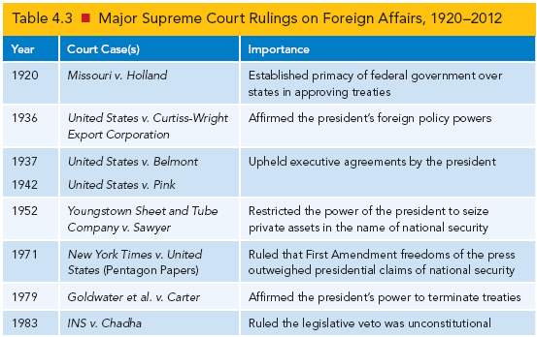
Judicial Interventions in Foreign Policy
Notes:
Learning Objective Number: 4.4

Slide 17
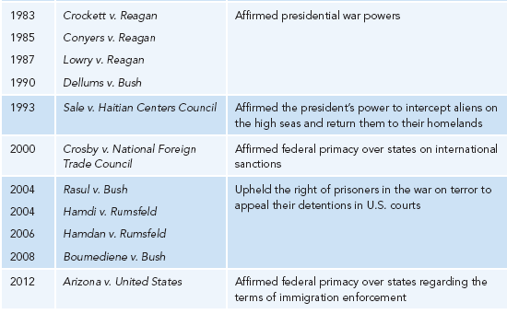
Judicial Interventions in Foreign Policy

Slide 18
Legal Quandaries in the War on Terror
Controversies in the war on terror
Declaration of global war on terror after 9/11
Not against nation-states, despite invasion of Iraq and Afghanistan
Difficulty tracking results because of civil wars and unrest
Conflict with detainees in Cuba
Scandal at Abu Ghraib prison in Iraq
Supreme Court forced to rule on conditions, treatment, legal questions
Congressional backlash
Notes:
Learning Objective Number: 4.4

Slide 19
Conclusion
The president remains the hub of foreign policy due to formal and informal powers as well as norms and historic patterns.
The constitutional “invitation to struggle” will remain a defining fixture of U.S. foreign policy making.
Personal aspects of presidential decision-making and character will also continue to affect policy outcomes.

